Slide 1
École d'Été Temps Réel - 2026
Embedded software In space
Eliott Peron
09/09/2026

Slide 2
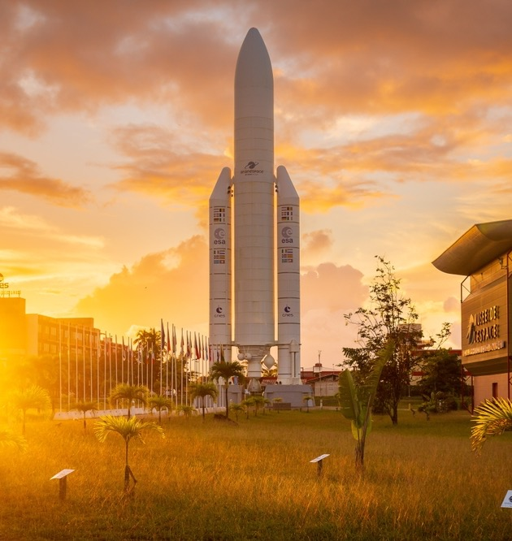
Summary
01
Space-ificties
02
IMA and TSP
03
Autocode
04
Validation
05
Quality
06
To infinity and beyond

Slide 3

Space-ificties
This document is the property of CNES. It cannot be used without their consent

Slide 4
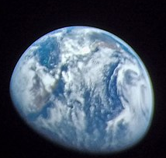
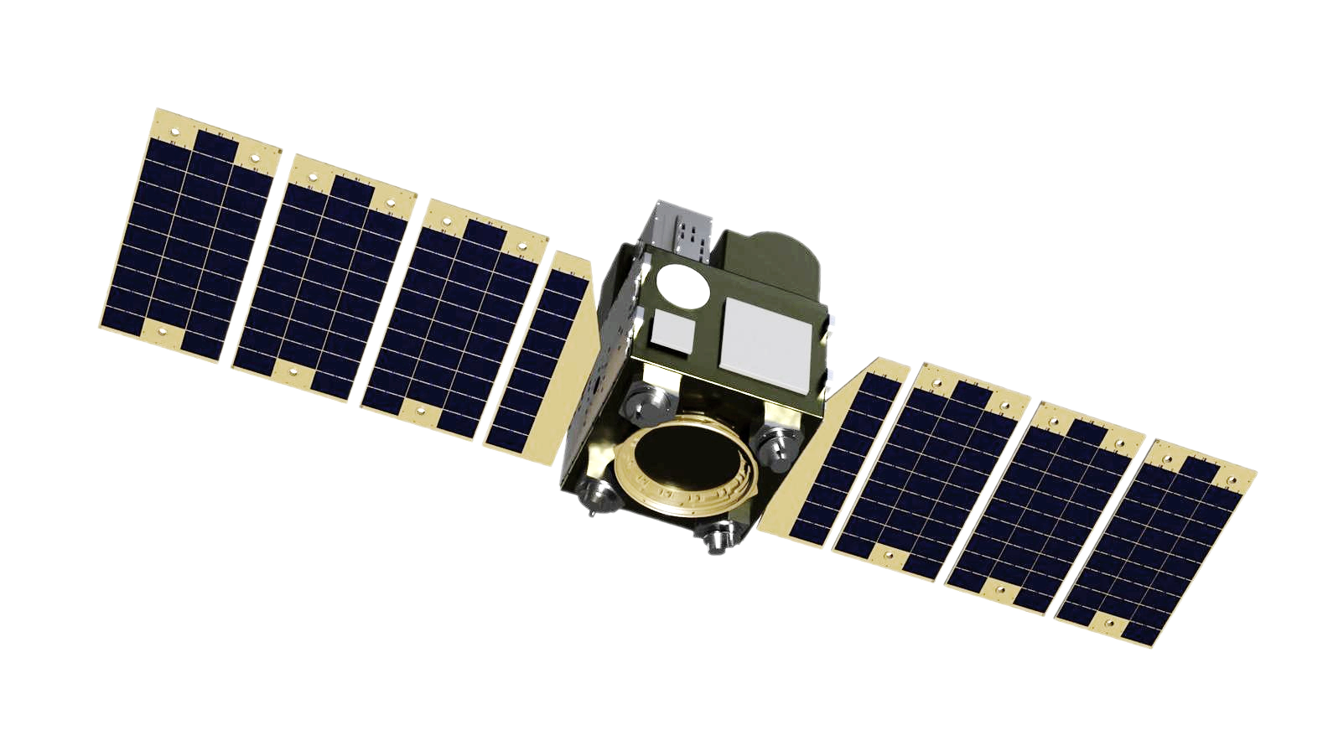
On-board: the spacecraft
01 - Space-ificties
Notes:
PF :
enjeux
équipements
scao
télécoms
évocation robustesse aux radiations
haute criticité
CU :
enjeux
types d'instruments
algorithmie bord
missions & applications
moindre criticité

Slide 5
On-board: the spacecraft
01 - Space-ificties
Specific instruments
(cameras, spectrometers, etc.) )
Tele-
communication
PAYLOAD
AOCS: Attitude &
Orbit Control System
  Specific operability
Infrastructure enabling the mission High criticality
Spacecraft mission
lower criticality
Thermal regulation
PLATEFORM
  Specific on-board .
  algorithms .
Radiations tolerance /
resistance
Notes:
PF :
Specific equiments & algorithms
AOCS
Telecoms
Thermal regulation
Resistance aux Radiations
Enjeu : tout e qu’il faut pour faire permettra au satellite d’accomplir sa mission : haute criticité
CU :
enjeux
types d'instruments
algorithmie bord
missions & applications
moindre criticité

Slide 6
OBC: ON-BOARD COMPUTER
01 - Space-ificties
Spacecraft
Platform equipments
OBC
Payload instruments
Processor cores (CPU)
Memories (RAM, QSPI, etc.)
FSW
HW interfaces
HW interfaces
FPGA matrix
HW interfaces
Notes:
OBC 1 ou plusieurs par mission on peut en avoir 1 pour la PF et 1 pour la CU voir plusieurs pour une CU complexe
C'est quoi / où : un composant électronique intégré sur le satellite (comparable processeur de PC)
il y a quoi dedans (des interfaces / des mémoires / un processeur / du FPGA)
Soit un FPGA couplé avec un processeur
Soit soc
Les types d’interfaces courantes : de l’i2c, du spi, du spw, de l’ethernet, de l’uart
Un peu ce que l’on veut grâce au FPGA

Slide 7



A Quick history of On-board computers (1/3)
01 - Space-ificties
ERC32
LEON2FT
LEON4, GR740
Temic Atmel: 32 bits ;
20 MIPS* / 25 MHz ; SPARC V7
PLEIADES
Atmel: 32 bits ;
80 MIPS* / 100 MHz ; SPARC V8
MEGHA-TROPIQUE
Gaisler: > 400 MHz, 4 cores
ZYNQ (Xilinx): > 600MHz, mass production
IDEFIX© rover, Nanosats, ATHENA
2004
2010
2025+
2001
2008
2019
IMS T805E
LEON3FT, GR712RC
LEON5
NOEL5
RISC-V
NG-Ultra (NX)
VERSAL (Xilinx)
STM: 32 bits transputer ;
2.2 MIPS* / 20 MHz
DEMETER, MYRIADE
Gaisler: 32 bits ;
80 MIPS* / 100 MHz ; SPARC V8 ; 2 cores
SCOC3 (SPOT 6)
*MIPS : Million Instructions per Second
FUTURE SPACE MISSIONS
Notes:
Bref panorama de ce qui se faisait / se fait / se fera → intro vers cours 3 (HW)

Slide 8
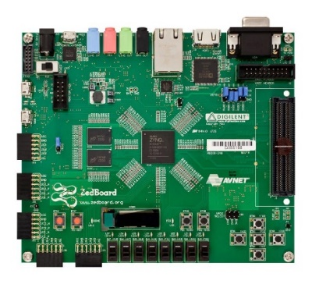
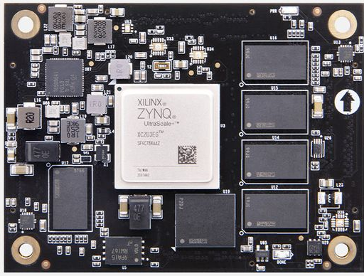
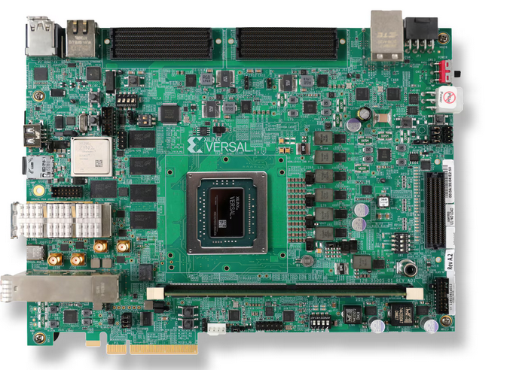
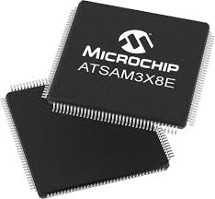
A Quick history of On-board computers
01 - Space-ificties
Focus on COTS processors (Rad-Tol)
Xilinx Zynq-7xxx
2 ARM Cortex A9 cores
@ 400-800 MHz
(1000-2000 MIPS)
Xilinx UltraScale+
2 ARM Cortex R5 cores
@1GHz
4 ARM Cortex A53 cores
@500MHz
Xilinx Versal
2 ARM Cortex R5 cores
@1GHz
2 ARM Cortex A72 cores
@2GHz
IA engines
Microchip SAM3X
Cortex M3
@ 84 MHz
For equipments
Notes:
Bref panorama de ce qui se faisait / se fait / se fera → intro vers cours 3 (HW)

Slide 9

A Quick history of On-board computers
01 - Space-ificties
Main European Microprocessors in Space (Rad-Hard)
In the meantime on PC…
MIPS*
MIPS*
GR712 (2 cores)
Spot4
Spot5
Proteus
Myriade
Pleiades
Spot6-7
Payloads /
equipments
*MIPS : Million Instructions per Second
Raspberry Pi
2
Desktop
PC
Resources limitations
Power
Weight
Space environment
Radiations
Particles
Explosion of computing power
Computers diversity and characteristics:
another source of complexity
Notes:
Bref panorama de ce qui se faisait / se fait / se fera → intro vers cours 3 (HW)
Un processeur type i7 est 200 fois plus puissant qu’un proc d’un satellite traditionnel

Slide 10
Which OBC for which mission?
01 - Space-ificties
NEED OF HIGH TRL
      Deep space exploration, telecomunication or long-term missions, etc.
        → Qualified OBC (LEON for instance)
NEED OF COMPUTING POWER
Earth observation or Science missions, heavy on-board treatments, etc.
    Future generation of qualified OBC (LEON for instance)
    Powerful COTS
COST / AVAILABILITY CONSTRAINTS
      New space or short terms missions, etc.
        Simple COTS
HIGH RADIATIONS / VIBRATIONS / TEMPERATURE TOLERANCE
  Depends on mission’s orbital characteristics
    Mostly qualified OBC
    Or COTS with extra test campaigns
ARCHITECTURE CONSTRAINTS
      Mechanical, thermal, power consumption constraints, centralized of decentralized spacecraft…
        One or several OBC, with one or several processor cores each.

Slide 11
Focus on space envrionment
01 - Space-ificities
EXTREME TEMPERATURES
+200°C in the light
-273°C in the shadow
→ Constraints on spacecrafts architecture and functionnalities
ROUGH RADIATIVE ENVIRONMENT
Ionizing particles
Leading to electronics malfunction (SEU, SEL, etc.)
→ Constraints on spacecrafts architecture, ability to communicate, and fucntionnalities
RISK OF DEBRIS
Atmosphere is thin, but still there → friction
Collision with debris detection and avoidance
→ Constraints on spacecrafts architecture, maneuverability
This document is the property of CNES. It cannot be used without their consent
Notes:
Les laisser proposer des solutions pour mitiguer les SEU

Slide 12
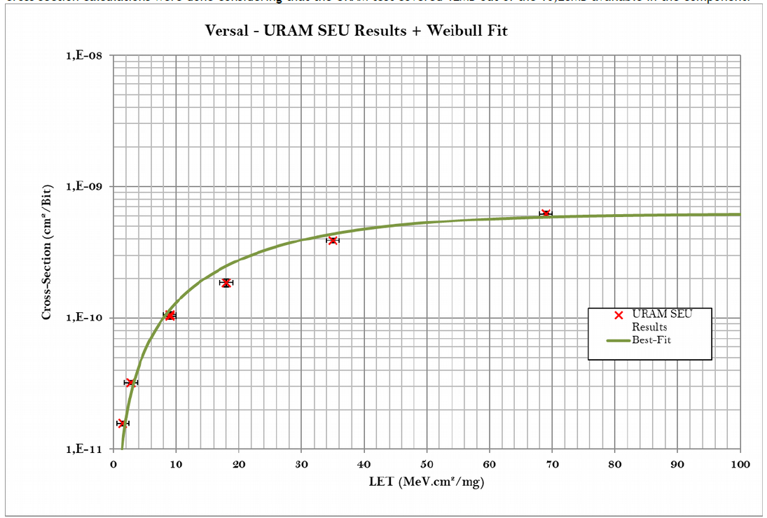
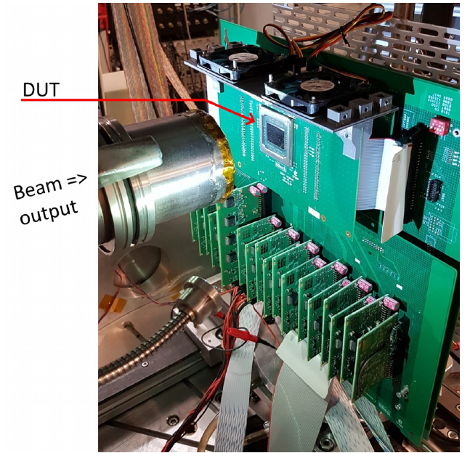
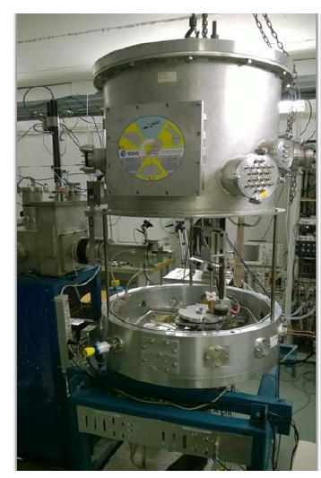
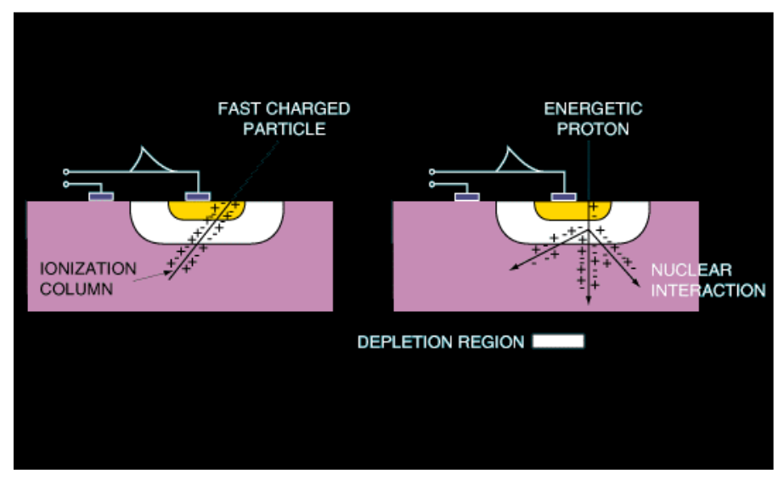
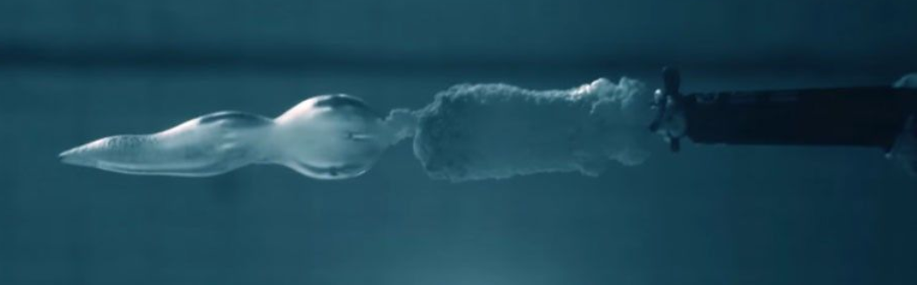

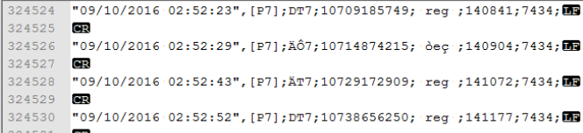
Component selection : radiation
01 - Space-ificities
Latchup :
“ high current flows and if the power supply is maintained, the device can be destroyed by thermal effect.”
SEU
“An SEU is a single bit flip, i.e. the change of state of a storage element, such as flip-flops, latches or SRAM cells”
TID
” Induced by the transfer of ionising energy from the radiation exposure, which thermalized in the creation of electron-hole pairs in the component material. “
Galactic cosmic rays deposit energy in an electronic device,
after Lauriente and Vampola).pdf
This document is the property of CNES. It cannot be used without their consent

Slide 13
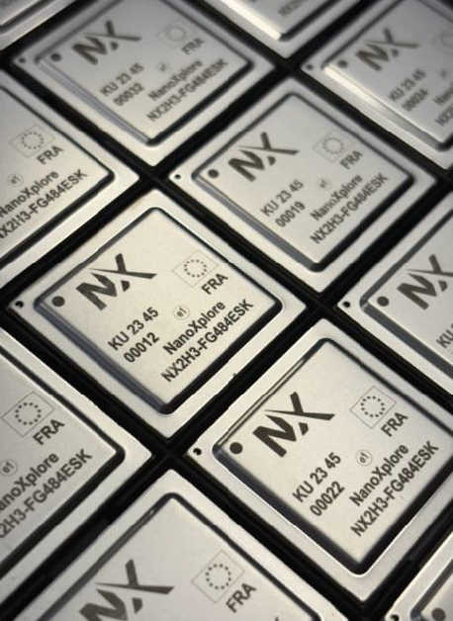
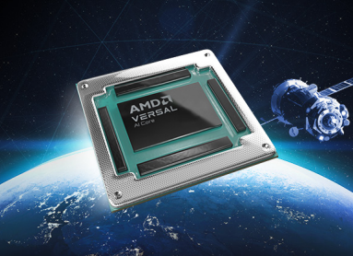
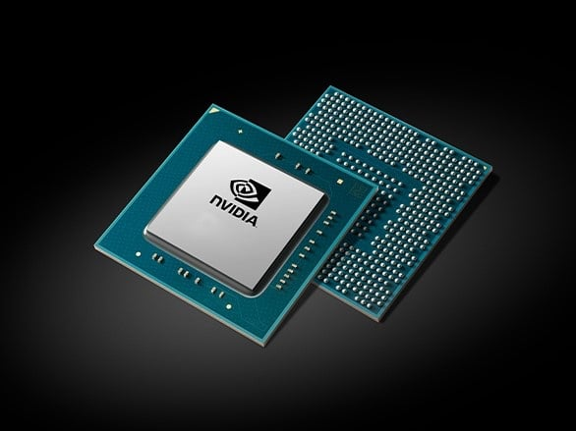
Component selection : radiation
01 - Space-ificities
+ | +++ | +++
++ | ++ | ++
+++ | + | +
  RadHard (Radiation Hardened)
    built for radiation (specific silicon process/PDK or IP library)
    Radiation guaranteed by datasheet
    Space quality certified ESCC or QML
    silicon die controlled tracability
  Performance
  Price
  quality
  RadHard
  RadTol (Radiation Tolerant)
    « everyday component » sold for space use
    most of the time COTS rebranded for space after dedicated tests
    radiation data and qualification variable
  RadTol
  COTS
  COTS (Commercial Off-The-Shelf)
    Generic application component (built for other market than space)
This document is the property of CNES. It cannot be used without their consent
Notes:
Composant RadHard (Radiation Hardenned)
Conçu pour les radiations ( Techno ou bibliothèque spécifique)
Données radiation « contractuelles » (mesures faites par le fabriquant)
Souvent qualifié selon une norme ESCC ou QML
traçabilité de la puce garantie
Composant RadTolerant :
Argument commercial du fabriquant (surveiller les données) .
souvent des composants commerciaux testés et « re-brandés » par le fabriquant
souvent la dose est mise en avant (attention la dose spatiale est lente différent de la dose pour certaines applications )
pas de qualification
données radiations non fournies
fabrication non garantie reproductible (usine différente, changement de masque de fabrication) => impact sur les données radiations

Slide 14
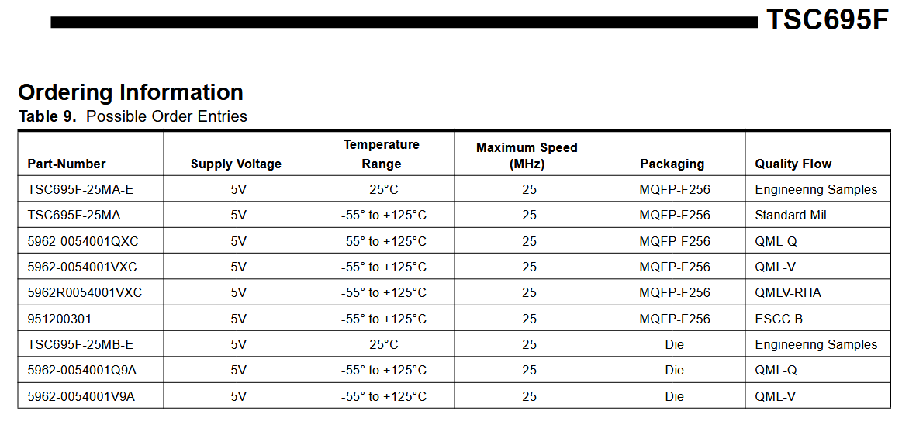
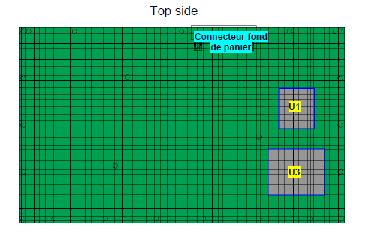
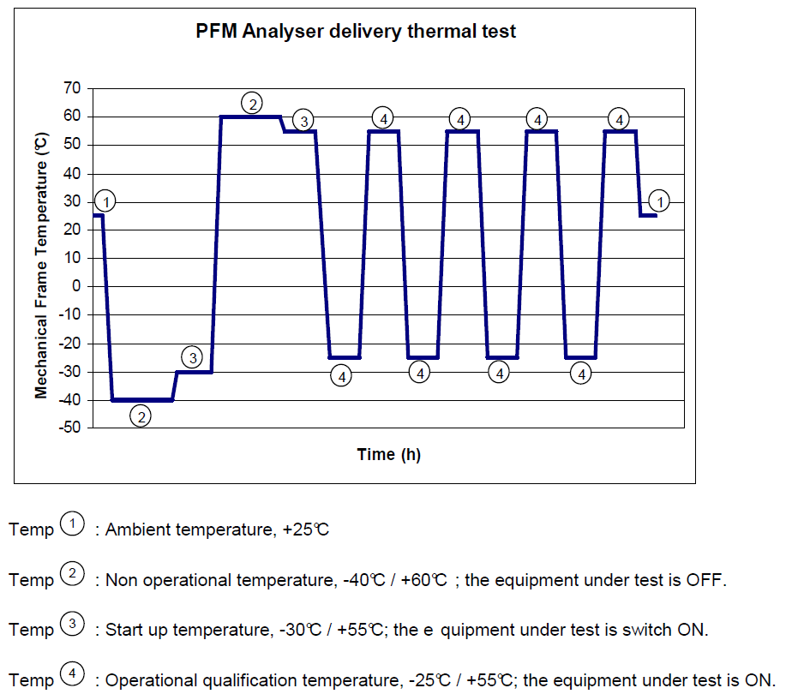
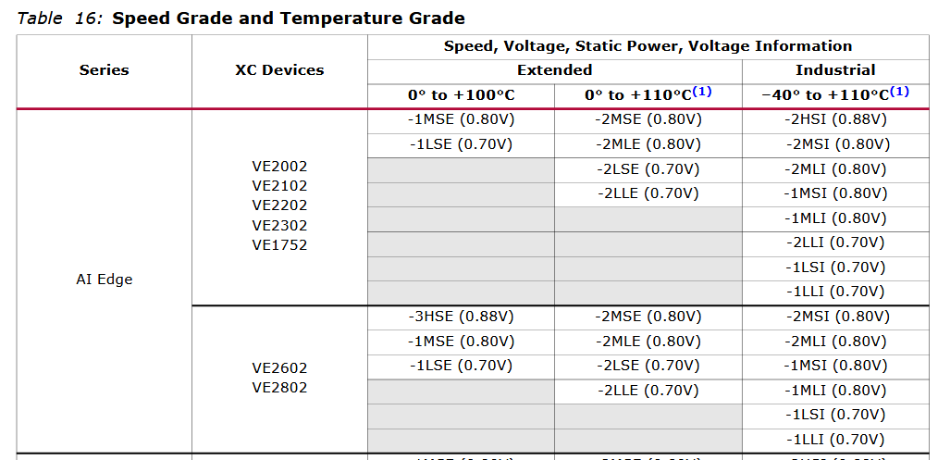
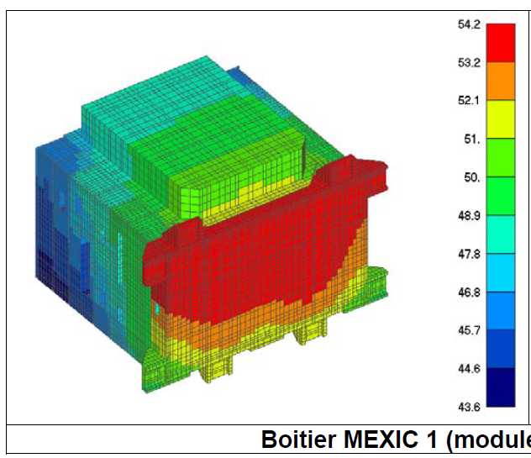
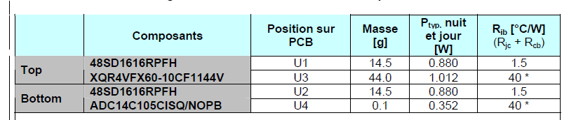
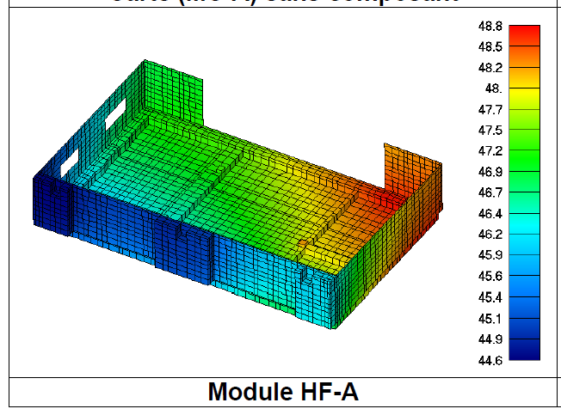
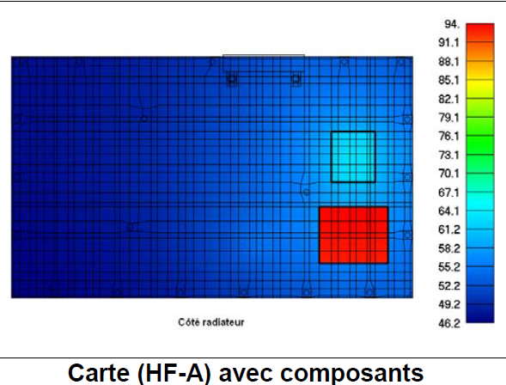
Component selection : thermal
01 - Space-ificities
Temperature range (ex. from -157°C to +121°C (ISS profile)
  Consider using extended temperature range
Gradient and dissipation
  take care of the board component place
This document is the property of CNES. It cannot be used without their consent

Slide 15
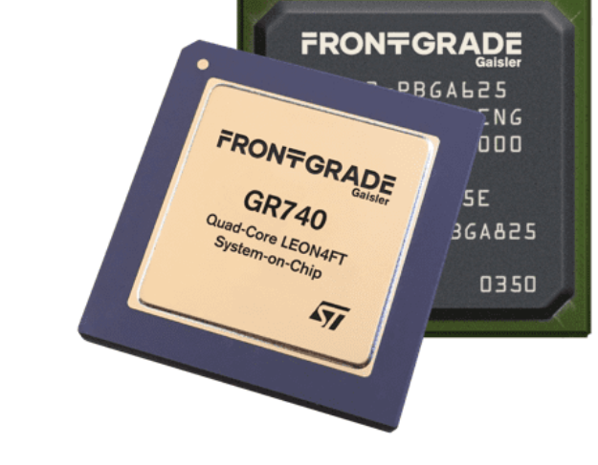
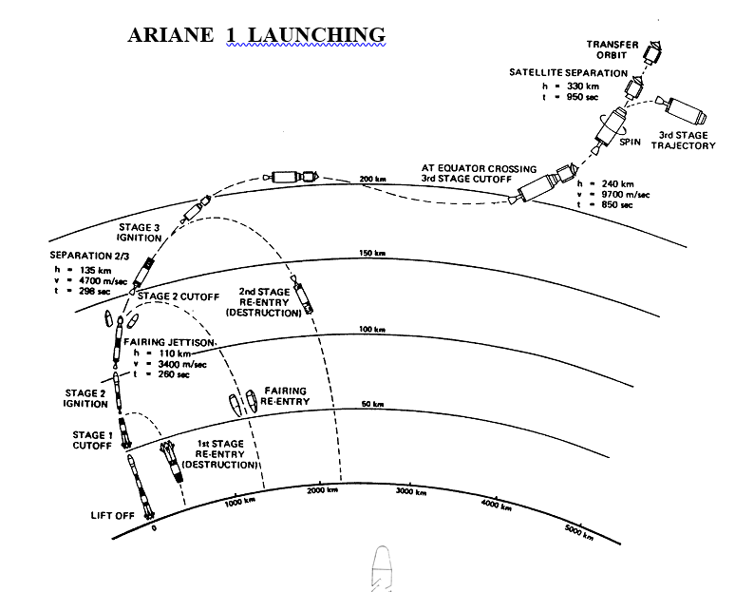
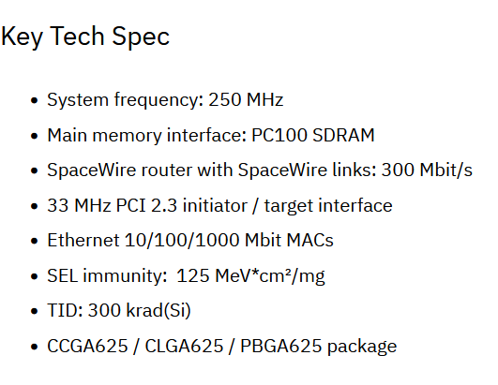
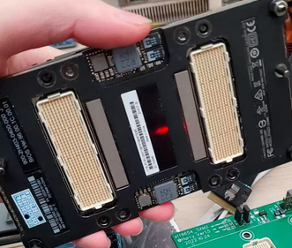
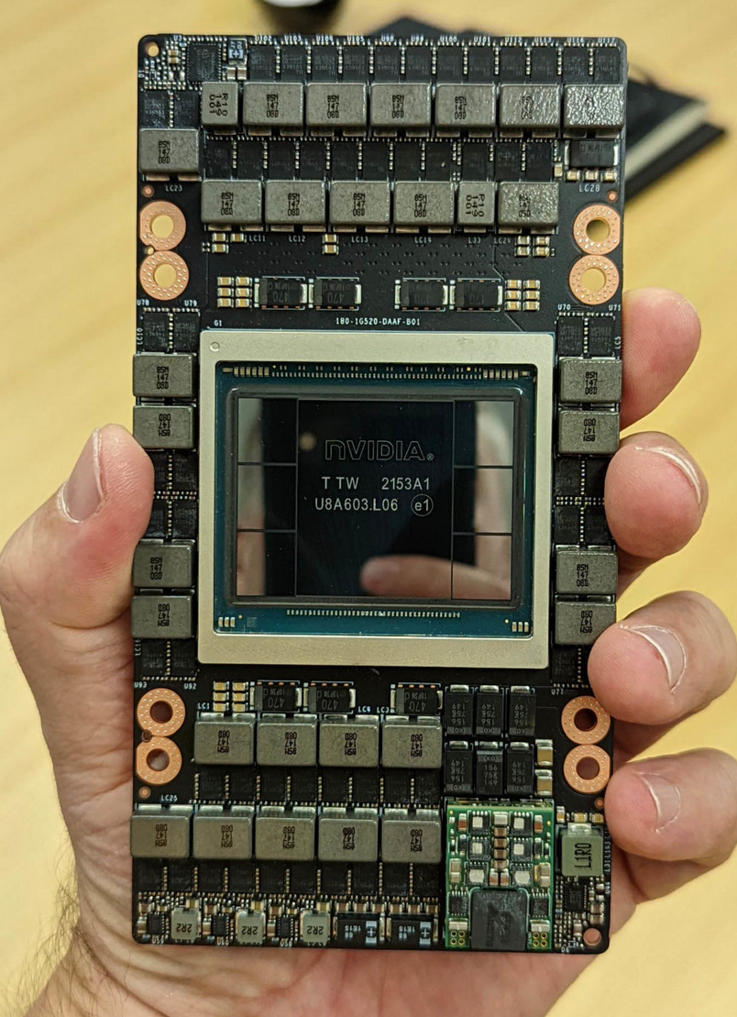
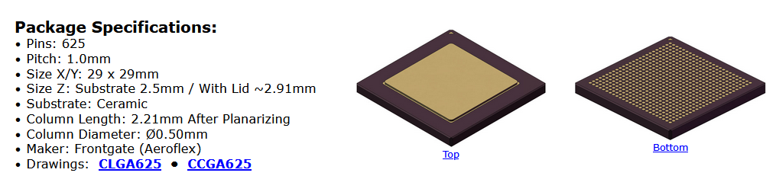
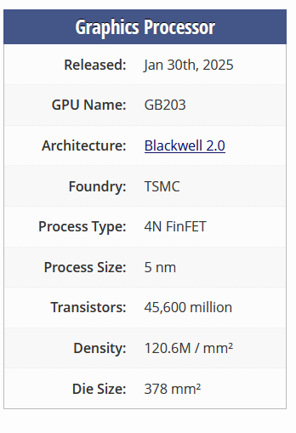
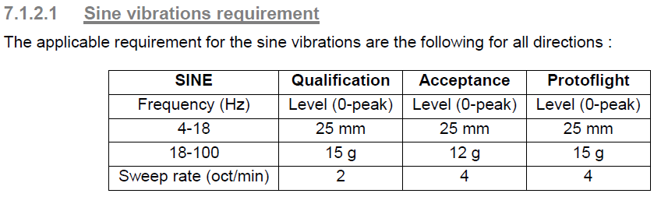
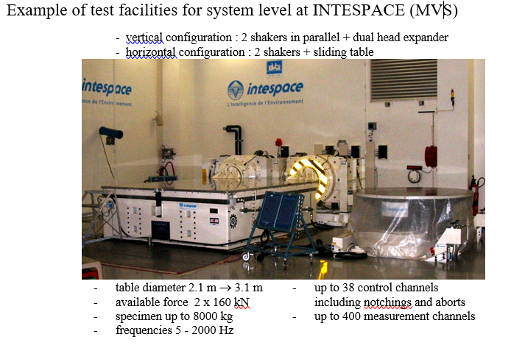
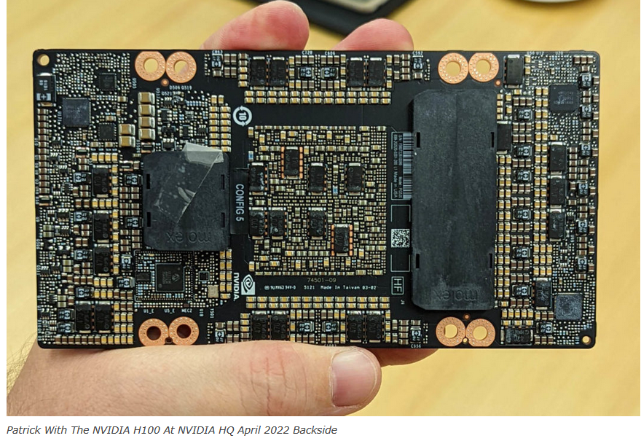
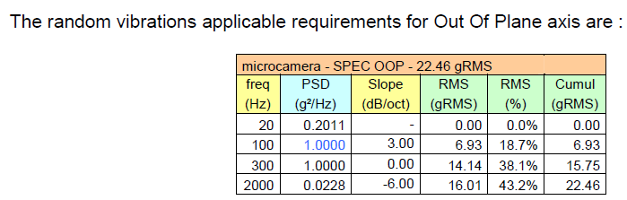
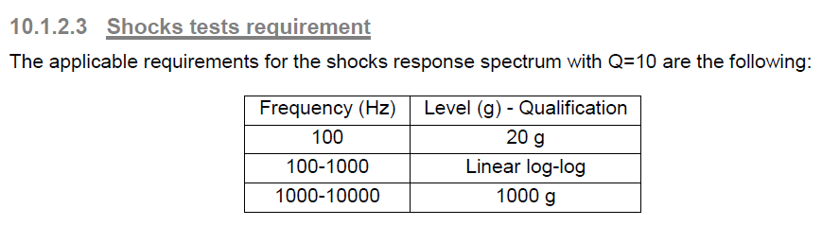
Component selection : Mechanical
01 - Space-ificities
Impact:
  Component pitch and size
  Component material
  Component position on board
ST 65nm
space
SMX5 board
This document is the property of CNES. It cannot be used without their consent

Slide 16
Missions of Flight Software
01 - Space-ificities
ON-BOARD SOFTWARE ACTIVITIES
Boot/automatic seq.
Modes
Time
Monitoring
Memories
AOCS
Thermal / Power control
Navigation
Payload algorithms
TM/TC
On-board protocols
(inter-sat protocols)
MANAGEMENT
PROCESSING
COMMUNICATION
AMOUNT OF REAL-TIME FUNCTIONS: A SOURCE OF COMPLEXITY
Several real-time cycles
Asynchronous treatments
Several priorities
Hard-real-time constraints (equipments, fault detection)
Notes:
Les missions, en gros (s'assurer qu'il démarre bien / lien IF / s'assurer de la bonne santé du sat / l'algorithmie bord / l'autonomie du sat / la communication avec le sol / la gestion des données et des versions du sat)

Slide 17
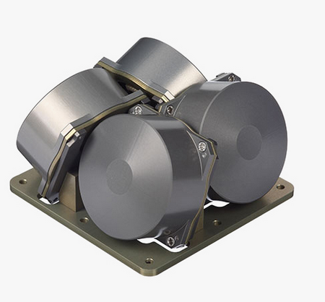
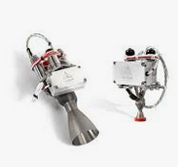
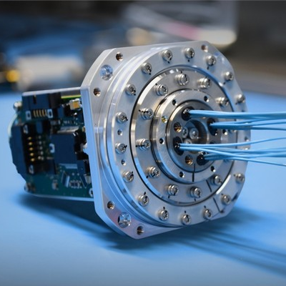
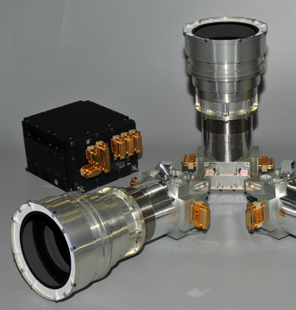
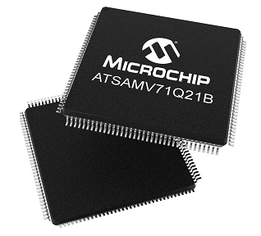
Focus on software embedded within equipment
01 - Space-ificities
(incomplete) LIST OF EQUIPMENT CONCERNED
Reaction Wheels
Thrusters
SADM
(Solar Array Drive Mechanism)
Cameras
THE SOFTWARE INSIDE
WHAT ABOUT CRITICALITY?
Very small
(~5000 lines of code maximum)
Main functionnalities
Depends on equipment’s usage
Software Development & Quality
Equipment turn ON/ OFF
Execute output orders (ex: turn solar array)
Send data (ex: camera image)
Platform equipement:
Critical
Often developed by equipemnt architects
… who are not software experts
The level of quality has to be controlled
Mostly runs on µcontrollers
Payload instrument or software reloadable:
Less critical
Notes:
Une (légère) digression : le LV des équipements spatiaux
De quels équipmeents parle t’on ? Roues de réactions, startrackers, SADM, cameras
Quelle taille de logiciel : tout petit, tourne sur des microcontrôleurs, qu’estc-e que ça fait ? ON / OFF, pilote par rapport à une consigne, envoie de données
Quels besoin de criticité: ça dépend
En pratique coment c’est fait : sur un con de table par des gnes sont c’est pas trop le métier… y a des vrais challenges – anecdote

Slide 18
Constraints for Flight software
Everyday constraints
01 - Space-ificities
COMPUTERS DIVERSITY AND CHARACTERISTICS
AMOUNT OF REAL-TIME FUNCTIONS
Number of OBCs to manage
Type and number of available memories
Storage size of FSW: binaries files
Execution space for FSW: RAM size
CPU frequency and number
Maturity (TRL) and
resistance of OBC
Communication between embedded functions
Execution time and frequency of embedded functions
Quality level of embedded functions
Notes:
Les contraintes : empreinte mémoire, empreinte temporelle / grande variété d'applications qui doivent s'exécuter en parallèle

Slide 19
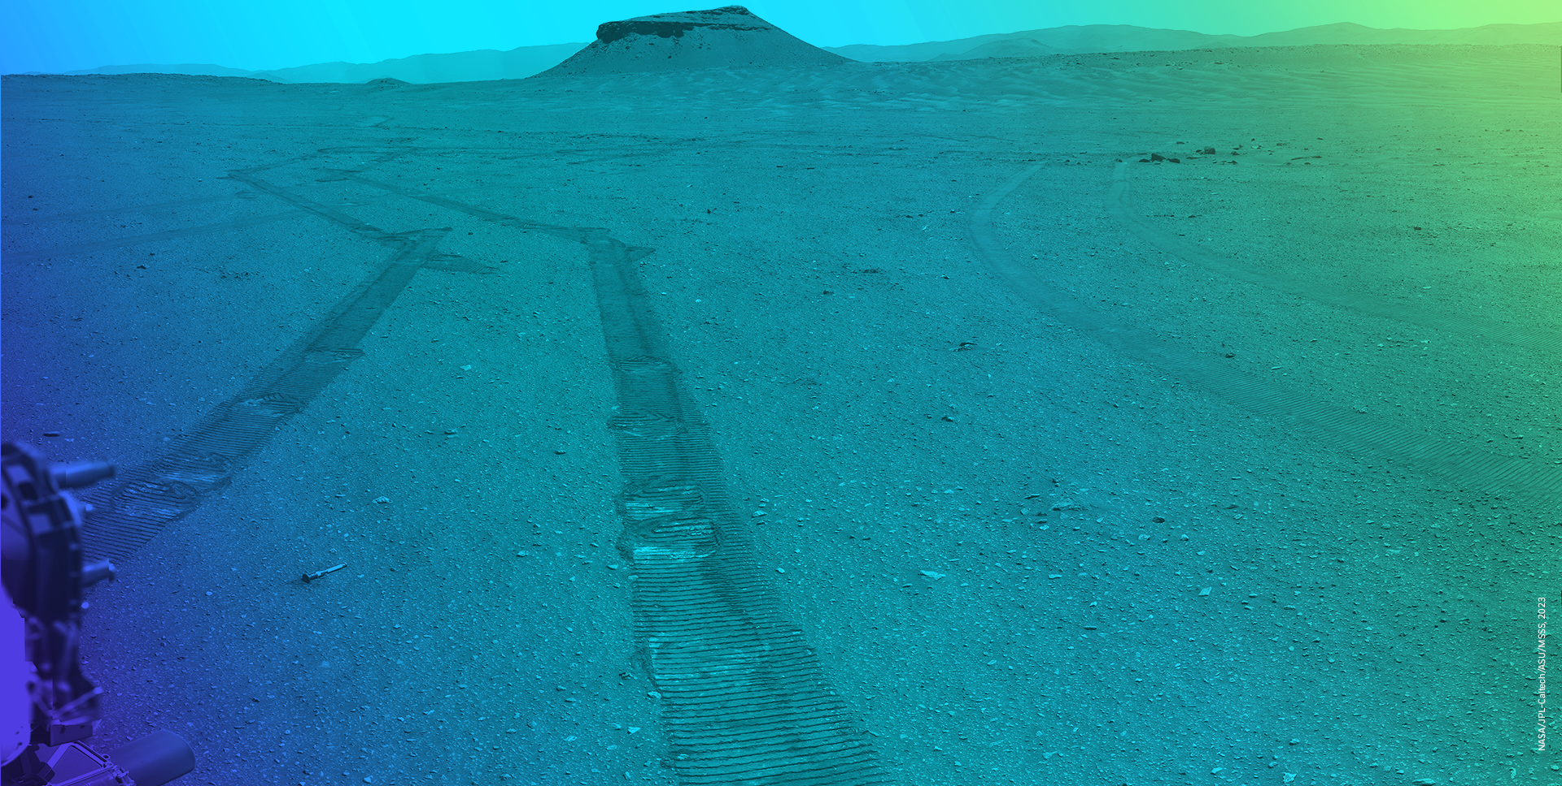
IMA and TSP
This document is the property of CNES. It cannot be used without their consent
Notes:
Poser la question et les laisser répondre.
Le résultat d’un système temps-réel doit être correct dans l’intervalle de temps où la réponse est attendue → On parle de « Deadline »
Sinon il est incorrect.
On entend parler parfois de deux type de temps-réel:
Soft : un deadline miss résulte uniquement en une baisse de la qualité de service du système. Trouver un exemple
Hard : un deadline miss résulte dans une erreur critique du système.

Slide 20










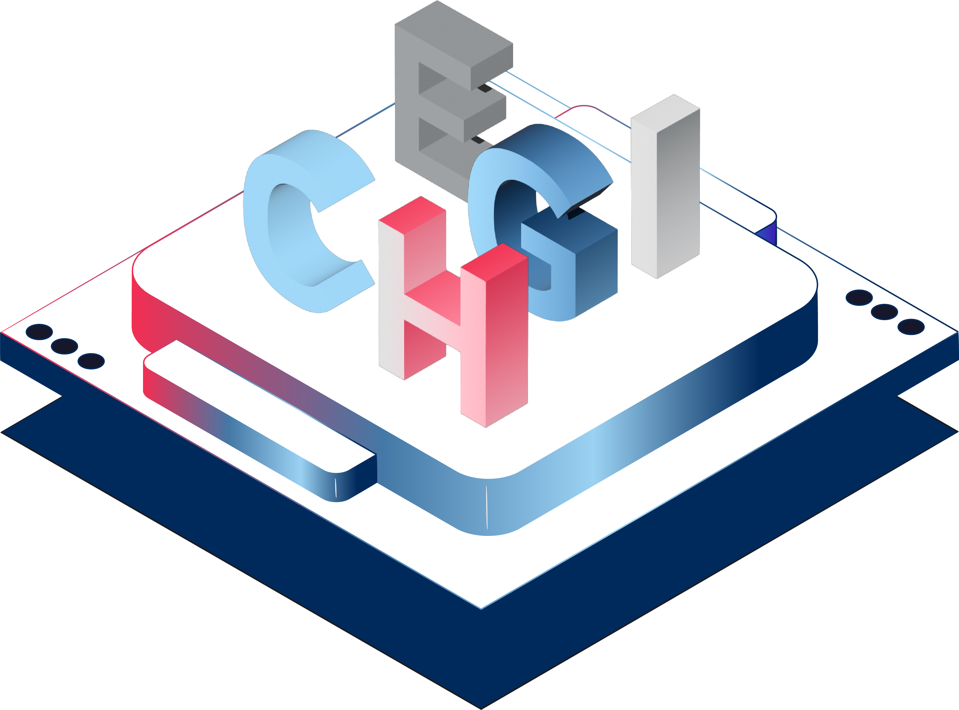

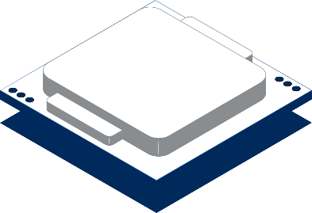








IMA
An inspiration from aeronautics
02 – IMA and tsp
IntegratED modular avionics
Concept developed for aircrafts and widely deployed on Airbus and Boeing spacecrafts since A380 and B777.
9 functions,
9 computers.
9 functions,
2 identical computers.
      Basics Principles :
        Capture the needs (in CPU power and I/O) from all the functions of the aircraft
        Select the appropriate number of computers and switches allowing to cover all the needs
        Distribute all the functions across the computers
        Configure the network
This document is the property of CNES. It cannot be used without their consent

Slide 21
IMA building blocks
02 – IMA and tsp
But IMA could be possible only thanks to strong design properties:
A deterministic and configurable network (AFDX)
An on-board software architecture allowing to guarantee:
  Strong segregation between applications hosted by the same computer (confinment of anomalies during software execution)
  An independant development and validation between the different hosted applications (potentially qualified by different suppliers)
An architect / integrator in charge of managing all the rationalization:
  Capture the needs (in CPU power and I/O) from all the functions of the aircraft
  Select the appropriate number of computers and switches allowing to cover all the needs
  Configure the distribution of all the functions across the computers
  Configure the network
This document is the property of CNES. It cannot be used without their consent

Slide 22
IMA benefits
02 – IMA and tsp
Benefits:
Reduction of the number of HW to qualify (+ SW execution platform)
Very fast reliability of the HW (+ SW execution platform) used (intensively used in many different ways by different suppliers).
Capability to decrease the quality assurance level of software applications that have a lower criticality rather than always apply to all of them the worst criticality of the computer.
Capability to host several SW functions, potentially from different suppliers on the same processor/SoC, while keeping an independent qualification process between these functions.
Reduction of weight, volume and consumption of electronics
This on-board software architecture has been described in the ARINC653 standard and relies on Time and Space Partitioning.
Drawbacks:
A single component is used in many computers : common failure mode.
Suppliers loose their skills in HW developments and SW execution platform
This document is the property of CNES. It cannot be used without their consent

Slide 23
What is Time and Space PArtitioning ?
02 – IMA and tsp
Concept
Each application software is called a partition and has its own memory space and time slots allocated on the CPU.
This segregation of resources makes possible to develop and qualify each application independently.
Memory space
P1
0
T
CPU time
XNG
P2
P3
P4
CPU#0
T
P5
T
CPU#1
CPU time
XNG
XNG
Static memory allocation
Static time allocation
= no dynamic preemption
This document is the property of CNES. It cannot be used without their consent

Slide 24
TSP : advantages and drawbacks
02 – IMA and tsp
  Advantages
      Allows an independent development and validation of the different partitions (absence of non functional side effects).
      Ease the reuse of recurrent functions.
      Ease the performances analysis (WCET and reactivity) because much less preemptions by other functions (and less functions per software).
      Capability to decrease the quality assurance level of software applications that have a lower criticality rather than always apply to all of them the worst criticality of the computer.
  Drawbacks
      CPU and memory overhead (but acceptable for space OBSW projects)
      The CPU time that is not consumed by one partition can not be used by the others.
      Incompatible with strong response time ( < 10ms) required by HW.
  Crucial role of the resource allocation to guarantee the coverage of Project requirements without impacting the qualification context of the other partitions.
This document is the property of CNES. It cannot be used without their consent

Slide 25
Sharing I/O devices across partitions
02 – IMA and tsp
P1
P2
P3
Mandatory to have a server component for shared devices to guarantee an independent QoS (Quality of Service) for client partitions, that is the corner stone of IMA/TSP
I/O server
SW
HW registers
Ctrl/status
HW
FPGA/SoC IP
I/O link
This document is the property of CNES. It cannot be used without their consent

Slide 26
CPU budget for such an I/O server component
02 – IMA and tsp
TSP : no immediate reactivity with interrupts ! Polling becomes much obvious.
=> The only crucial question is : what is the worst acceptable response time ?
Schedule the IO partition according to the needs of each client partition wrt :
Throughput
Latency
Periods
But also :
Duration of each emission/reception
Level of HW support for these operations (byte-per-byte, complete message, n messages, virtual channels, …)
This document is the property of CNES. It cannot be used without their consent

Slide 27
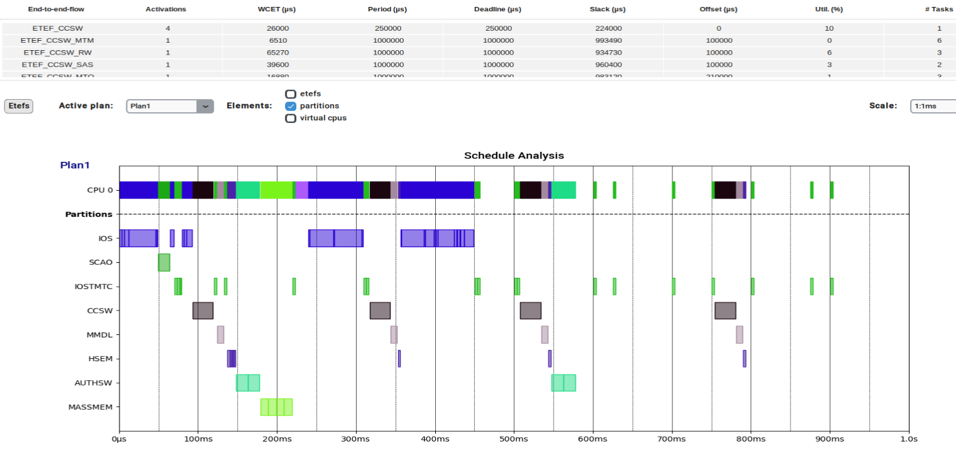
CPU budget for such an I/O server component
02 – IMA and tsp

Slide 28














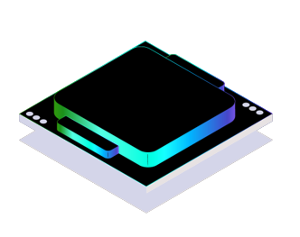

KOSMOS
02 – IMA and tsp
FASTER
Components available off-the-shelves #DevOps
Our goal
Provide our ecosystem with a generic software infrastructure that standardizes essential functions and allows users (eg. Scientists) to focus solely on the added value of the space mission.
»
AOCS
NAV
CCSW
IOS
HSEM
MMDL
Payload1
Payload 2
…
BETTER
All the components are qualified ECSS-B.
»
A653
CHEAPER
Risks reduction thanks to a modular and mature infrastructure
Hyperviseur (XtratuM-NG)
µP
28

Slide 29

Autocode
This document is the property of CNES. It cannot be used without their consent

Slide 30
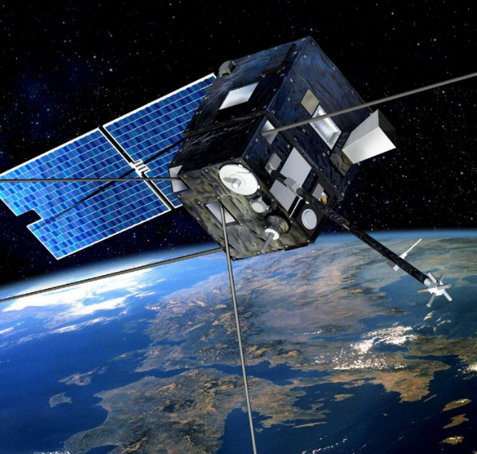
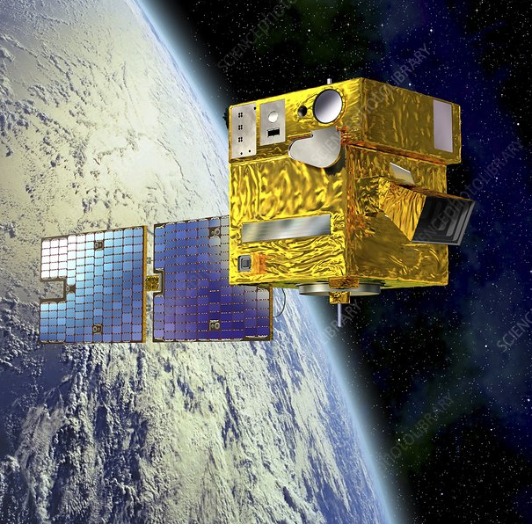
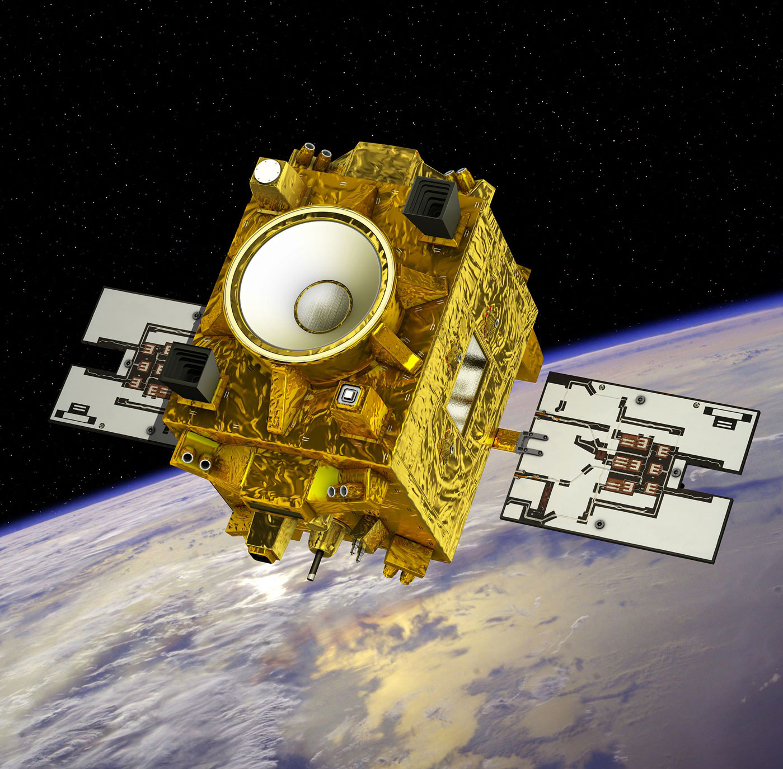
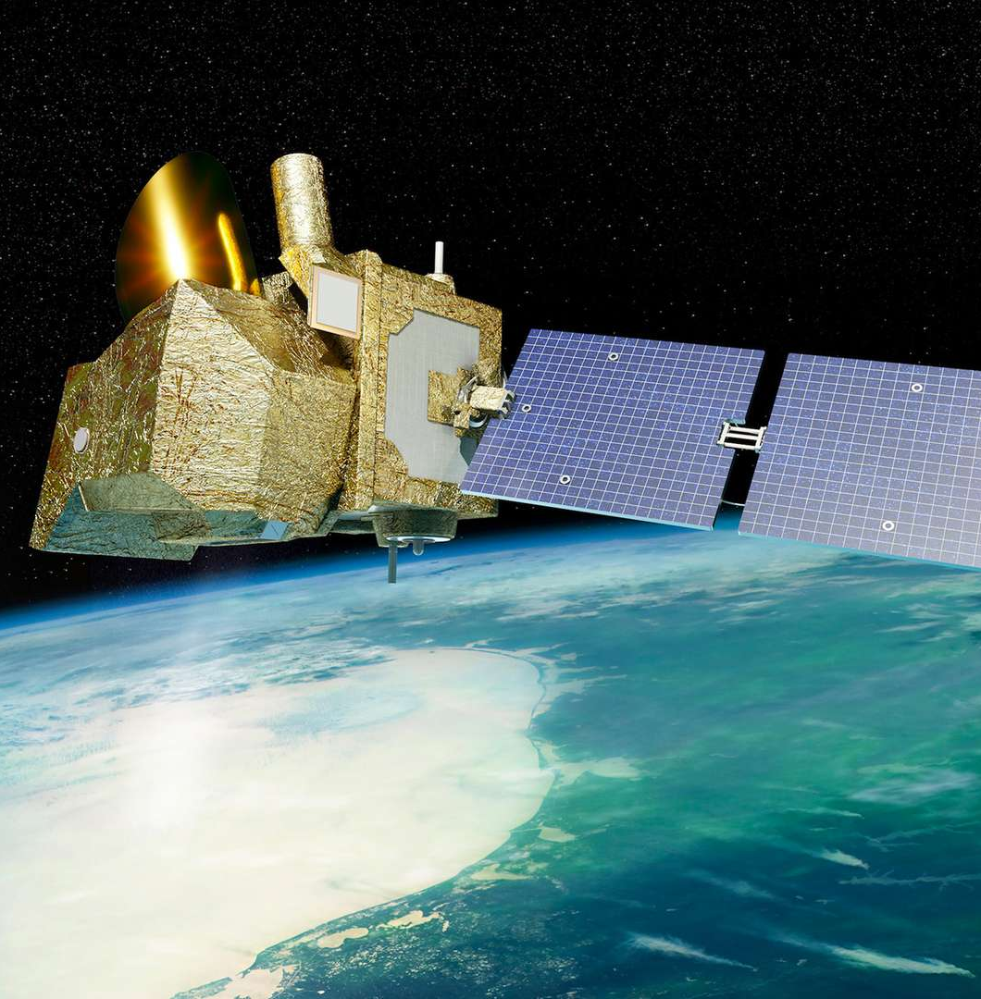

AUTOCODING AT CNES: an origin story
03 - Autocode
~2010
2010
2016
2024
DEMETER
AOCS algorithm prototype
PICARD
AOCS algorithm prototype
MICROSCOPE
Several AOCS modes
MICROCARB
Several AOCS modes
End-of life experiment
End-of life experiment
No equipment-specific
functionalities
No equipment-specific
functionalities
Very specific use-cases
Huge validation effort
No format coherency between autocodes
Manual integration within complex Flight SoftWares
No ECSS compliance
This document is the property of CNES. It cannot be used without their consent
Notes:
At first these activities had a huge impact on software development teams, who had to manually integrate autocodes within complex FSW, with strong adherence between AOCS algorithms and equipment drivers. The validation effort was substantial (all unitary testing was made by hand directly on generated code), which led to heavy additional testing activities whenever an autocode modification/bugfix was necessary.
Generated code was not ECSS-compliant, and there was no format coherency between autocodes.

Slide 31



AUTOCODING AT CNES: an origin story
03 - Autocode
NEW SPACE: A CHANGE OF PARADIGM
Increase of onboard computing power
Strong time constraints
Increasing diversity of use-cases
Increasing complexity of onboard treatments
Lower budgets
2019
2023
2026
EYESAT
Full AOCS
NESS
Full AOCS
IDÉFIX (MMX) Rover
Full ACS
Startracker
algorithms
Image Detection
algorithms
RF
algorithms
Emergence and consolidation of an "autocoding process" at CNES
This document is the property of CNES. It cannot be used without their consent
Notes:
Historically code generation was used to help AOCS algorithms development and integration, but in the last few years, with the increase of onboard computing power and the emergence of strongly time-and-budget-constrained New Space projects (EyeSat, N3SS, MMX Rover), its scope became wider and wider.

Slide 32



From concept…
03 - Autocode
Validation Scenarios (MIL)
Tuning simulation campaigns
Performance simulation campaigns
Robustness simulation campaigns
Coding Rules
Readability
Consistency
Code generation compatibility
Matlab®
Simulink®
Complete Simulator
AOCS algorithm model
Sensors Models
Safe Mode
Model
Nominal – Guidance 1 Model
Actuators Models
Nominal – Guidance 2 Model
Nominal – Guidance 3 Model
Environment Models
Matlab functions
This document is the property of CNES. It cannot be used without their consent
Notes:
ultimately, a simulator. This simulator consists of models representing the algorithm to be implemented in the FSW and models of the environment and equipment.
Once the simulator is assembled, tuning simulation campaigns, as well as performance and robustness simulation campaigns are performed in Model-In-the-Loop (MIL) mode, to validate and verify the developed software.

Slide 33

… To autocoded algorithm
03 - Autocode
AOCS algorithm model
Simulink Notes & Report generator
AOCS Autocode Package
SAFE
Model
Nominal – Guidance 1 Model
Embedded Coder
Nominal – Guidance 2 Model
Nominal – Guidance 3 Model
Matlab functions
Machine learning qualification Handbook
ECSS-E-HB-40-02A
Embedded Coder
Configuration
MathWorks recommendations
This document is the property of CNES. It cannot be used without their consent
Notes:
June 2021 : handbook describing the process of generating code from models and guidelines related to this process.
Embedded Coder allows significant time, human and financial resources savings to produce on-board applications. This approach eliminates the need to recode, in another language, algorithms that were developed for simulation and tuning purposes in MATLAB/Simulink.
Simulink Notes: comment his/her Simulink code at the same time he/she develops it. These notes can be exported to a word document with the report generator toolbox, allowing an automated generation of the model description document.
configuration of Embedded Coder has been selected carefully and is a trade-off between the configuration recommended by Mathworks and the configuration recommended by the ESA Handbook. The configuration depends on the MATLAB/Simulink version, and thus is updated when necessary.
After these steps are completed, the process of generating code can be started using the appropriate toolboxes. Prior to code generation, an internal tool checks compliance with the coding rules. Then, if compliant, code is generated in a ready-to-use delivery package.

Slide 34



autocode package
03 - Autocode
Autocode (.c/.h)
Refruns (reference tests)
Autocode API:
  AOCS_autocode_initialize()
  AOCS_autocode_step()
Inputs
Expected outputs
Matlab / Simulink sources
Parameters
Model validation reports
Autocode package configuration / traceability
This document is the property of CNES. It cannot be used without their consent

Slide 35
Autocode integration
03 - Autocode
AOCS Autocodes Execution
Refrun parameters
Environment Setup
Setup AOCS parameters with default values
Call AOCS_autocode_initialize();
Main loop (while(1))
Read partition inputs (through ports / buffers)
Fill autocode input structure with (formatted) partition inputs
Call AOCS_autocode_step();
Convert autocode output structure content into (formatted) partition outputs
Write partition outputs (through ports / bufers)
This document is the property of CNES. It cannot be used without their consent

Slide 36

Partition validation facility
03 - Autocode
Resident Software (RSW)
partition-level test FSW
SANDBOX partition
PARTITION
under test
OUT
IN
UART / Memory Dump Logs
(including Sandbox instrumentation traces)
IN
OUT
Sandbox Test scripts
IN
OUT
Tests Logs Checker
TRACES
IN
TRACES
OUT
Hypervisor (XtratuM-NG)
Test reports
This document is the property of CNES. It cannot be used without their consent

Slide 37

Validation
This document is the property of CNES. It cannot be used without their consent
Notes:
May not be real-time
A washing machine is an embedded system.
A flight SW runs on an embedded system and most applications have real-time needs

Slide 38

WHY TO USE A SIMULATOR ?
04 - validation
« A simulator is a technical device (software or/and hardware) to reproduce at a chosen or possible level the behavior of a real phenomenon or a physical or functional system. »
This document is the property of CNES. It cannot be used without their consent

Slide 39
Why not the real system ?
04 - validation
Availability
  Not yet built
  Not available for testing
Costs
Complexity
  Not easily configurable
  Need to parallelize
  Closed loop needs
  anomalies
Security
  Risk of damage
This document is the property of CNES. It cannot be used without their consent

Slide 40






EXAMPLE : satellite simulator
04 - validation
TOMS
Training Operations and Maintenance Simulators
Satellite
In orbit
Station model
Ground network
Test Mgnt through
GUI
Ground segment
Telemetry
Telemetry
Remote control
Remote control
This document is the property of CNES. It cannot be used without their consent

Slide 41
WHICH KINDS OF SIMULATORS for which goals ?
04 - validation
Studies
O
A
B
C
D
E
F
AIT simulators
Study simulators
Simulators by theme
System simulators
Performances analysis
Technical solutions/Algorithms
New concepts analysis
Tuning
AOCS validation
Thermal/Electrical validation
Flight software validation
Sub-system functional chains validation
System functional chains validation
Technical Qualification
Operational Qualification
Future operators training
Investigations in case of anomalies
This document is the property of CNES. It cannot be used without their consent

Slide 42


















SimulatOR OVERVIEW
04 - validation
A model
is a basic building block of the simulator, which simulates a feature or piece of equipment, configured and connected to each other
DEVELOPING
CONFIGURING
❶
❷
Model library
Simulator = Σ of models
Variante = Σ of instances
(instance = configurated model)
❸
ANALYSING
RUNNING
❹
Test driver
Driving the simulation
Scenario
This document is the property of CNES. It cannot be used without their consent

Slide 43




Main KindS of simulators/Test benches
04 - validation
Fully numerical
Processor in the loop (PIL)
Hardware in the Loop (HWIL)
This document is the property of CNES. It cannot be used without their consent

Slide 44
Sensors/Actuators models or other equipments
04 - Validation
Separation of (all of which being optionnal)
Functionnal simulation => Physics, measurements. Either modeled by a simple function or by using more complex libraries.
Command-Control simulation
Protocol simulation
Example of models :
Antennas : X-band, S-band, Inter-Satellite Link
Sensors : Sun Sensors, Magnetometers, Star Trackers, GNSS
Actuators : Reaction Wheels, Thruster, Magnetotorquers
Electrical Power : Battery, Solar Array, PCDU
Payloads
This document is the property of CNES. It cannot be used without their consent

Slide 45

Quality
This document is the property of CNES. It cannot be used without their consent

Slide 46




ecss
05 - QUality
https://ecss.nl/
3 types of documents
  Standard – « ST »
  Applicable requirements
  Handbook – « HB »
  Guides / Recommandations for applying applicable requirements
  Technical Memorandum – « TM »
  In the process of standardization
4 branchs
  Management « M »
  Engineering « E »
  Quality « Q »
  Sustainnability « S »
This document is the property of CNES. It cannot be used without their consent
Notes:
ECSS standard européen :
Définit un ensemble de règles pour le développement d’un projet spatial
À différent niveau : des documents à livrer à des règles d’implémentation.
Exemple BR
Exemple empreinte mémoire

Slide 47
Applicable standards
05 - QUality
ECSS-S-ST-00C
SYSTEM DESCRIPTION
SPACE PROJECT MANAGEMENT BRANCH
M40
CONFIGURATION ET INFORMATION MANAGEMENT
SPACE PRODUCT ASSURANCE BRANCH
Q30
DEPENDABILITY
Q40
SAFETY
Q80
SOFTWARE PRODUCT ASSURANCE
SPACE INGENEERING BRANCH
E40
SOFTWARE ENGENEERING
Q-80 & E-40 applicable requirements are implemented according to SOFTWARE CRITICALITY
This document is the property of CNES. It cannot be used without their consent
Notes:
For SW, there are 2 ECSS standards that are applicable according the SW criticality :
ECSS-Q-ST-80 for SW Product Assurance
ECSS-E-ST-40 for SW Engineering
There are also the M40 for the configuration management, including SW
And the Q30 for dependability and Q40 for safety, especially to define the criticality

Slide 48







Functional criticality
05 - quality
Remarkable differences between criticality classes
  Usually for C : decision coverage unmeasured / statement coverage = 100%
  Usually for D : decision coverage unmeasured / statement coverage = 80%
This document is the property of CNES. It cannot be used without their consent
Notes:
The main differences between SW criticality classes are as follows
ISVV (Independant Sw Validation and Verification) is only required for SW criticality A and B
ISVV requires that the tester be different from the developer.
For criticality A, the company must be different, wheras for criticality B, the company can be the same but the team must be different
Then, the level of the metrics differs according to criticality levels …
And also the code coverage differs :
usually, 100% decision coverage is required for criticality B
usually, 100% statement coverage is required for criticality C
usually, 80% statement coverage is required for criticality D

Slide 49



Coding standards for C
05 - Quality
  RELIABILITY, SECURITY & MAINTAINABILITY
Misra C 2012
coding standard
(from automotive industry)
RNC
coding standard
(common + C + embedded)
KOSMOS
coding standard
(tailorization from RNC)
https://www.misra.org.uk/
RNC-CNES-Q-HB-80-501
RNC-CNES-Q-HB-80-536
LVCUGEN-SPAP-AQ-0271-CNES - LVCUGEN Coding Standard.pdf
This document is the property of CNES. It cannot be used without their consent
Notes:
To verify the quality of code written in C language, there are some standards that define coding rules to ensure the RELIABILITY, SECURITY & MAINTAINABILITY of embedded SW
The most famous is the MISRA C standard, created for automative industry but also used to develop other embedded systems
There are also The CNES coding standard and the KOSMOS coding standard which is a tailoring of several standards and tools
The philosophy is to have 1 coding standard for each language and of course a tool to verify these coding rules

Slide 50


Onboard software pipelines at CNES
05 - QUALITY
P1 : Quality pipeline to check C rules
P2 : TU/TI pipeline for tests at partitions level
P3 : TV pipeline with full software
P4 : Delivery pipelline
First with jenkins, now with gitlabci
This document is the property of CNES. It cannot be used without their consent

Slide 51
To infinity and beyond
This document is the property of CNES. It cannot be used without their consent

Slide 52
02 - current trends
Focus on 5 axes (non-exhaustive)
1 - On-board autonomy
2 - Software-defined & reconfigurable architectures
3 – Hardware targets (No HW…No SW !)
4 - Development & testing
5 - Modularity and updates
This document is the property of CNES. It cannot be used without their consent

Slide 53

06 - Future
02 - current trends
[1/5] On-board autonomy
10/15 years ago
Rule‑based FDIR*
Almost all data processing done on ground
Autonomous navigation limited to deep‑space probes
2026 +
On‑board inference (image triage, anomaly detection)
Autonomous navigation & advanced FDIR
This document is the property of CNES. It cannot be used without their consent
53

Slide 54

06 - Future
02 - current trends
[2/5] Software-defined & reconfigurable architectures
10/15 years ago
Hard‑wired payloads
Minimal reconfiguration capability
Minimal in‑orbit retasking capabilities
FPGA updates rare and highly constrained
2026 +
Fully reconfigurable navigation payload (e.g. Galileo 2nd Gen)
In‑orbit reprogrammable telecom platform (e.g. ESA Electra SDR )
NanoSats using Zynq7000 for adaptive mission logic
This document is the property of CNES. It cannot be used without their consent
54

Slide 55

02 - current trends
[3/5] Targets & architectures
06 - future
10/15 years ago
Rad750 (2005‒2015) dominated deep-space missions
LEON2/LEON3 used extensively in ESA missions
Strict avoidance of COTS CPUs for LEO missions
2026 +
ARM-based COTS compute stack (OneWeb)
High-end smartphone-class SoCs in orbit (OPS-Sat / ESA)
Increasing adoption of RISC‑V (e.g., ETH Zürich deployments)
This document is the property of CNES. It cannot be used without their consent
55
Notes:
Exemple de target cots utilisé pour des missions :
Sapdragon sur ingenuity

Slide 56

02 - current trends
[4/5] Development & testing
06 - future
10/15 years ago
Paper/Word/PDF requirement workflows
Limited system‑model integration
Verification mostly manual and slow
2026 +
Increase of end‑to‑end MBSE workflows (e.g. ESA using Capella/Arcadia)
Increasing use of digital twins* (Juice, ExoMars rover, and Ariane 6 avionics…)
Automated regression pipelines for flight software (GitlabCI, Jenkins…)
*digital twins : real-time virtual replicas of physical objects, systems, and processes
This document is the property of CNES. It cannot be used without their consent
56
Notes:
Expliquer ce qu’est un digital twin

Slide 57

02 - current trends
[5/5] Modularity & updates
06 - future
10/15 years ago
Security was mostly a compliance checklist, not architectural
Very limited OTA update capability
Monolithic flight software with large restart penalties
2026 +
Secure boot and hardware root of trust in new ESA LEO missions
Partitioned OSes (e.g. RTEMS SMP, seL4 research payloads)
Starlink and OneWeb perform fleet‑wide OTA* updates
*OTA : Over The Air update
This document is the property of CNES. It cannot be used without their consent
57

Slide 58


02 - current trends
How can we support these changes ?
06 - Future
On the HW side
Support new architectures (AI engines, RISC-V, GPU, dedicated IPs…)
Power consumption
Thermal dissipation
Radiation tolerance
On the SW side
Support new Operating Systems to enable new kinds of applications
Compliance with Space standards ? (e.g. ECSS)
Real time capacities ?
Memory footprint,
This document is the property of CNES. It cannot be used without their consent
58

Slide 59

02 - current trends
How can we support these changes ?
06 - Future
On the HW side
Support new architectures (AI engines, RISC-V, GPU, dedicated IPs…)
Power consumption
Thermal dissipation
Radiation tolerance
On the SW side
Support new Operating Systems to enable new kinds of applications
Compliance with Space standards ? (e.g. ECSS)
Real time capacities ?
Memory footprint,
How can Linux helps flight software
move to the next step ?
-> Hardware trends are not detailed in the frame of this course
This document is the property of CNES. It cannot be used without their consent
59

Slide 60

03 - Focus on Linux : A brief history
06 - Future
Linux and embedded systems : a success story !
Late 90s : μClinux enabled ports to a large variety of microprocessors
2000 : Arm-Linux synergy : low costs, low power consumption, and low heat generation
2005 : PREEMPT_RT project was initiated to provide a patch to the Linux kernel (enable real time features)
2008 : Android 1.0 was released, based on the Linux kernel
2024 : Embedded Linux is used in 44%-46% of embedded systems "Embedded Systems Statistics By Market Size And Technologies". Electro IQ. 24 February 2025
Embedded Linux 2026 trends : Edge computing, IOT (on Earth… but also in Space !)
Image source : https://electroiq.com/stats/embedded-systems-statistics
This document is the property of CNES. It cannot be used without their consent
60
Notes:
Preempt_rt un moyen de patcher le noyau linux afin de le rendre plus déterministe.
Depuis quelques années c’est maintenant de base dans le kernel linux

Slide 61
04 - Linux for space applications
06 - Future
Today
Most applications coded in C language
Specific hardware
(radiation tolerant for example)
Specific software
(compliant to space standards)
Small community
Lack of support
Increasing complexity (both HW and SW)
61

Slide 62
04 - Linux for space applications
06 - Future
Today
Most applications coded in C language
Specific hardware
(radiation tolerant for example)
Specific software
(compliant to space standards)
Small community
Lack of support
Increasing complexity (both HW and SW)
NEW
SPACE
This document is the property of CNES. It cannot be used without their consent
62

Slide 63

04 - Linux for space applications
06 - Future
Today
Most applications coded in C language
Specific hardware
(radiation tolerant for example)
Specific software
(compliant to space standards)
Small community
Lack of support
Increasing complexity (both HW and SW)
NEW
SPACE
This document is the property of CNES. It cannot be used without their consent
63

Slide 64
04 - Linux for space applications
06 - Future
Today
Tomorrow with Linux ?
Most applications coded in C language
Specific hardware
(radiation tolerant for example)
Specific software
(compliant to space standards)
Small community
Lack of support
Increasing complexity (both HW and SW)
NEW
SPACE
Allow the use of high level languages
Ease application porting
Plenty of compatible targets
Large community
Lot of support / documentation
A magic solution… really ?
64
Notes:
Developpement d’app pour gain d’autonomie à bord plus facilement

Slide 65
04 - Linux for space applications
06 - Future
Linux in Space is not that new…
This document is the property of CNES. It cannot be used without their consent
65

Slide 66

04 - Linux for space applications
06 - Future
1999
Flight Linux project [NASA] : extend COTS philosophy to software domain (kernel + APP : 500Ko, system RAM 4MB)
2003
QuakeSat [QuakeFinder LLC] : PC/104 x86 CPU module with Red Hat Linux
2005
UWE-1 [University of Würzburg] : Hitachi H8S 2674 16-bit with μClinux
2007
MidSTAR-1 [United States Naval Academy] : ARM Linux on a payload controller
2010
Falcon 9, Dragon [Space X] : Multiple COTS computers, custom Linux 3,2 with real-time patches
2011
X-Sat [Nanyang Technological University] : Linux on several StrongArm SA1110 processors for a payload controller
2013
IPEX [Cal Poly San Luis Obispo, JPL] : 400MHz Atmel ARM9, Linux 2.6.30
Dove satellites [Planet] : Low-power COTS x86 processors, Ubuntu server
PhoneSat satellites [NASA] : Google Nexus One and Nexus S with Android 2.2
2015
LightSail-1 [The Planetary Society] : Tyvak Intrepid v6 single-board computer
2017
Aalto-1 [Aalto University] : AT91RM9200-based Embedded computer, Linux 3.4 prepared with buildroot
2019
OPS-SAT [ESA] : Altera Cyclone V SoC (ARM dual-core Cortex-A9 MPCore, Cyclone V FPGA)
66
Notes:
À noter :
Space X sur leur lanceur falcon 9 sur leur capsule crew dragon sur starlink
Nasa avec ingenuity 2021 mars persévérance

Slide 67
04 - Linux for space applications
06 - Future
What do we fear ?
67

Slide 68
04 - Linux for space applications
06 - Future
  Real time constraints (memory, timers, scheduling…)
  Security (updates, unsafe languages, kernel complexity, ground/on-board communication…)
  Base level system requirements (kernel configuration, service management, system initialization, log system, file system…)
  Deployment / OTA updates
  Licence / export control
68
Notes:
Base level requ : est-ce que le HW à ce qu’il faut pour supporter une image linux
Licence : pour un plateformiste qui voudrait un logiciel pour sa plateforme générique la question de la licence va se poser
Deployment /update : recharger une image linux qu’est ce que ça veut dire comment déployer un nouvel applicatif

Slide 69

05 – LINUX and KOSMOS
06 - Future
Embedding an application catalog
Switch to another application when the experience is done
Load new applications from ground
Delete on-board applications if they are not needed anymore
Nothing less than a smartphone in orbit !
69
Notes:
Comme on l’a vu on cherche :
à avoir de plus en plus d’autonomie à bord
et le new space pousse pour des développements rapide

Slide 70


05 – LINUX and KOSMOS
06 - Future
No Space standard for embedded Linux yet (ongoing work – Space Grade Linux)
Container-based modular approach to ensure tasks segregation
Multi-politic scheduling approach to optimize CPU occupancy
70
Notes:
SGL : groupe de travail afin d’établir les bonne pratiques sur l’utilisation de linux dans le spatial et la génération d’une image pour le spatial
mais on est encore aux prémices
Container : virtualisation de plusieurs environnements linux sur un même hote et basé sur le même kernel mais isolé

Slide 71

05 – LINUX and KOSMOS
06 - Future
How to build and tune Linux for our needs ? The Yocto project
An open source collaboration project that helps developers create custom Linux-based systems regardless of the hardware architecture.
Provides a flexible set of tools and a space where embedded developers worldwide can share technologies, software stacks, configurations, and best practices
Used to create tailored Linux images for embedded and IOT devices, or anywhere a customized Linux OS is needed.
71
Notes:
Projet open source colaboratif de génération d’image linux pour l’embarquer ajuster au besoin

Slide 72




05 – LINUX and KOSMOS
06 - Future
How to build and tune Linux for our needs ? The Yocto project
BOOT
Device Tree Blob (dtb)
Kernel
Filesystem
/usr
/home …
Recipes : files that describe how to fetch, configure, build, and install a piece of software in an embedded Linux system.
Layers : Collection of files that describes a specific part of the future Linux distribution (= collection of layers)
Yocto : Set of tools used to generate the Linux distribution (boot + dtb + kernel + filesystem)
72

Slide 73
05 – LINUX and KOSMOS
Yocto layers for KOSMOS environment
Starts from poky (core-image-minimal)
Scarthgap branch
Use of PREEMPT-RT patch
Use of systemd for service management
Use of specific XNG (hypervisor) layer (Linux as guestOS + inter partitions communication)
Use of specific PUS layer
Only one payload application running on Linux
App Store
PUS
KOSMOS
SGL (Space Grade Linux)
XNG
Yocto Poky
73
Notes:
Poky c’est l’image de base mise à dispo par yocto avec le minimum vital

Slide 74



06 - New use cases : AUTONOMY
06 - Future
SESAM example
SESAM : Space Experiment for Satellite Artificial intelligence Monitoring
AI application using models to detect anomalies in telemetry data produced by the satellite's various instruments.
Enables systematic and continuous monitoring of multiple parameters while limiting data exchange between the ground and the edge.
Autonomous decisions made by the on-board computer following an anomaly. (i.e. restarting a non-critical partition)
74

Slide 75


06 - New use cases : SWARMS & constellations
06 - Future
SWARM : A group of satellites flying in close formation, exchanging data and performing computations that can be distributed.
Constellation: A group of identical satellites that work together to provide a service, generally ensuring almost complete coverage of the globe.
This document is the property of CNES. It cannot be used without their consent
75

Slide 76


06 - New use cases : SWARMS & constellations
06 - Future
What challenges ?
Inter-satellites communication
Navigation control algorithms
Cyber security
Continous updates
Complexity related to distributed systems

Slide 77


06 - New use cases : Robotics
06 - Future
Space ROS with embedded Linux
What is ROS ?
Robot Operating System : set of software libraries and tools that help build robot applications
Why use ROS for Space applications ?
Reduce project costs and schedule (widely use on Earth !)
Integrate open source flight heritage apps
Transistion technology from desktop-to-flight
Space ROS for what ?
Martian/lunar robots
Operating arms
LORA (see illustration)
77

Slide 78


TO REMEMBER
06 - future
New kinds of on-board proccessings need the flight software to adapt (AI, distributed computing, use of high-level languages…)
Linux can help move to the next step but is not a magic solution !
  Lack of garuantees regarding space standards
  No strong real-time guarantees
  Not ready for critical processings yet (typically platform processings)
  Easily usable for non-critical applications (typically payload processings)
  Notable initiatives but very little sharing (i.e starlink/spaceX)
    Use of custom/proprietary code
    Open initiatives are emerging !
      Space Grade Linux (SGL) https://elisa.tech/space-grade-linux-sig/

Slide 79
The end
This document is the property of CNES. It cannot be used without their consent

